Slide 1
Mutation Testing for Web Applications CS 4501 / 6501 Software Testing

Slide 2

Mutation Testing
review
Mutation operators
Rules that specify how to modify the code (mutate)
Well designed operators result in power tests
Mutation operators do one of two tasks
Mimic typical programmer mistakes
Encourage common test heuristics
We use mutation testing to
Help testers design high quality tests
Evaluate the quality of existing tests
Mutation scores $=\frac{\# mutants killed}{\# non−equivalent mutants}$
Subject programs
Run tests on subject program
Killing
mutant
Apply
mutation operators
Generate tests
no
yes
Record
killed
mutants
Distinguishable result?
mutants
Run tests on mutants
Must be
valid strings
(compilable)
Mutants are not tests, but used to find tests
Notes:
Goals of mutation operators:
Mimic typical programmer mistakes, thus trying to ensure that the tests can detect those mistakes
Force the testers to create tests that have been found to effectively test software
Uses of mutation testing
Help generate tests
Evaluate how good exiting tests (or criteria) are

Slide 3

Killing Mutants
review
Given a mutant m ∈ M for a ground string program P and a test t, t is said to kill m if and only if the output of t on P is different from the output of t on m.
The quality of tests depends on mutation operators
If the operators are designed well, the resulting testes will be very powerful
Different operators must be defined for different programming languages and different goals
Testers can keep adding tests until all mutants have been killed
A mutant is killed if there is a test case for which the test results are different from the original program
Killing mutants $≈$ exposing faults

Slide 4
Mutation Coverage
review
Mutation Coverage (MC): For each m ∈ M, TR contains exactly one requirement, to kill m.
The RIPR model
Reachability: the test causes the faulty (mutated) statement to be reached
Infection: the test causes the faulty statement to result in an incorrect state
Propagation: the incorrect state propagates to incorrect output
Revealability: the tester must observe part of the incorrect output
The RIPR model leads to two variants of mutation coverage: strong mutation and weak mutation

Slide 5
Designing Mutation Operators
review
Mutation Operators do one of two tasks:
Mimic typical programmer mistakes
Encourage common test heuristics
Researchers design many operators, then experimentally
Select the most useful operators
Remove the redundant operators
Effective Mutation Operators
If tests that are created specifically to kill mutants created by a collection of mutation operators O = {o1, o2, …} also kill mutants created by all remaining mutation operators with very high probability, then O defines an effective set of mutation operators

Slide 6
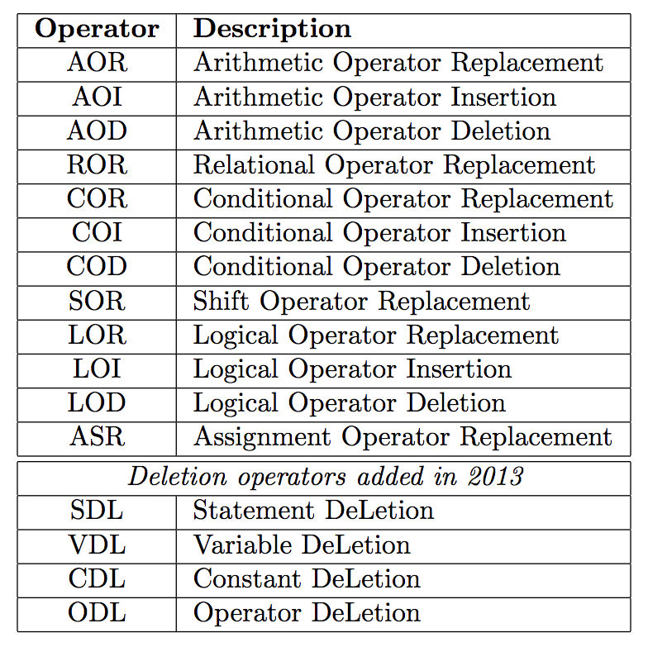
Unit / Method Mutation Operators
[http://cs.gmu.edu/~offutt/mujava/mutopsMethod.pdf]

Slide 7
OO Mutation Operators
[http://cs.gmu.edu/~offutt/mujava/mutopsMethod.pdf]

Slide 8
Web App Software Failures
Apr 2016: Clicking the browser back button while using the TurboTax web software caused a user to lose information
Feb 2015: Anthem suffered data breach
Jan 2014: Dropbox outage caused customers to lose information
Aug 2013: Amazon hosting service failure caused business to lose information and revenue
Sep 2012: Cyberattack on Bank of America, JPMorgan Chase, Citigroup, US Bank, Wells Fargo, and PNC resulted in denial of services
Jun 2012: Clicking the browser back button after successfully logging off Amazon website exposed payment information of the recent order
Mar 2012: BodyShop website turned a buy-one-get-one 50% off to a half price each item
Feb 2011: Over 120,000 users were unable to access email accounts due to Google mail service outage
Sep 2011: Failures at Target delayed and canceled many customers’ orders

Slide 9

Web Applications
How many of you have developed web apps ?
HTTP
Request
Web component₁
Have you noticed anything different from developing other software ?
HttpServlet
Request
DB
Web component₂
HttpServlet
Response
Web client
HTTP
response
Data
Web component_{n}
Web server
Web applications are constructed from diverse, distributed,
and sometimes dynamically generated web components

Slide 10
Challenges in Testing Web Apps
User’s ability to control web apps
Identifying web resources with URLs
Communication depending on HTTP requests
Communication via data exchanges
Novel control connections
Server-side state management
Client-side state management

Slide 11
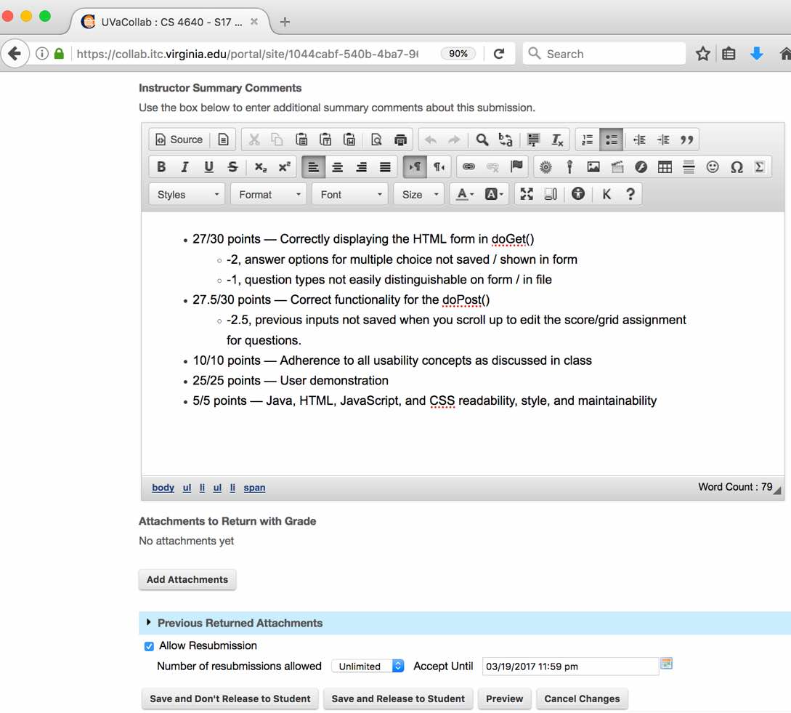
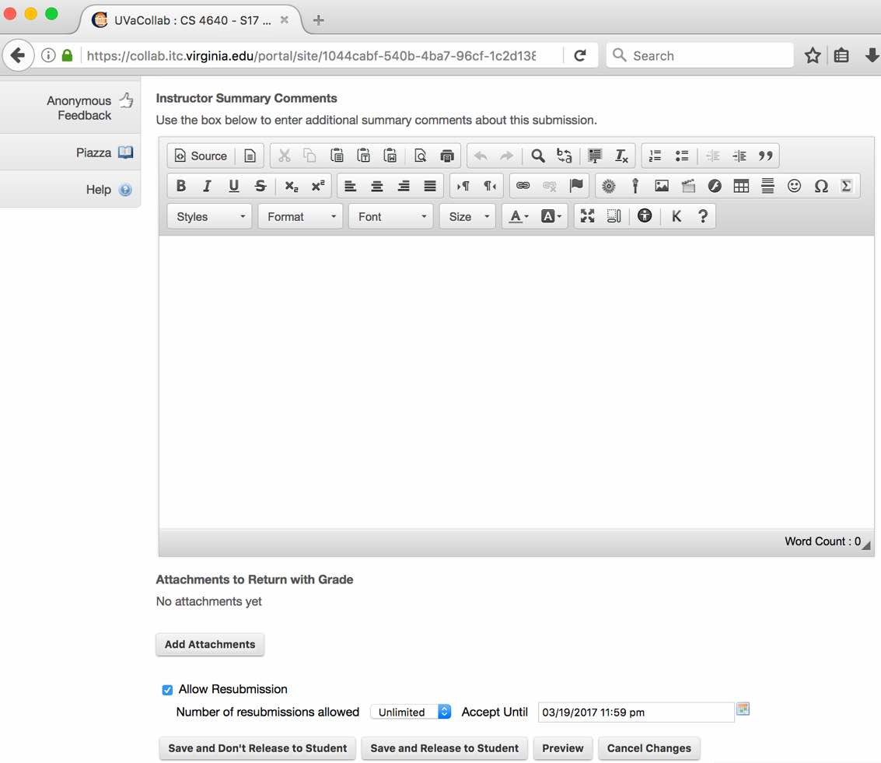
Ch #1 – User’s Ability to Control Web Apps
Potential faults:
unintended transitions
(such as breaking the
flow of execution)

Slide 12


Ch #6 – Server-side State Management
Potential faults: inappropriate scope setting
inappropriate session object initialization
omitting necessary session info
request
forward
request
page
request
request
forward
Client 1
page
session
request
page
application
Client 2

Slide 13
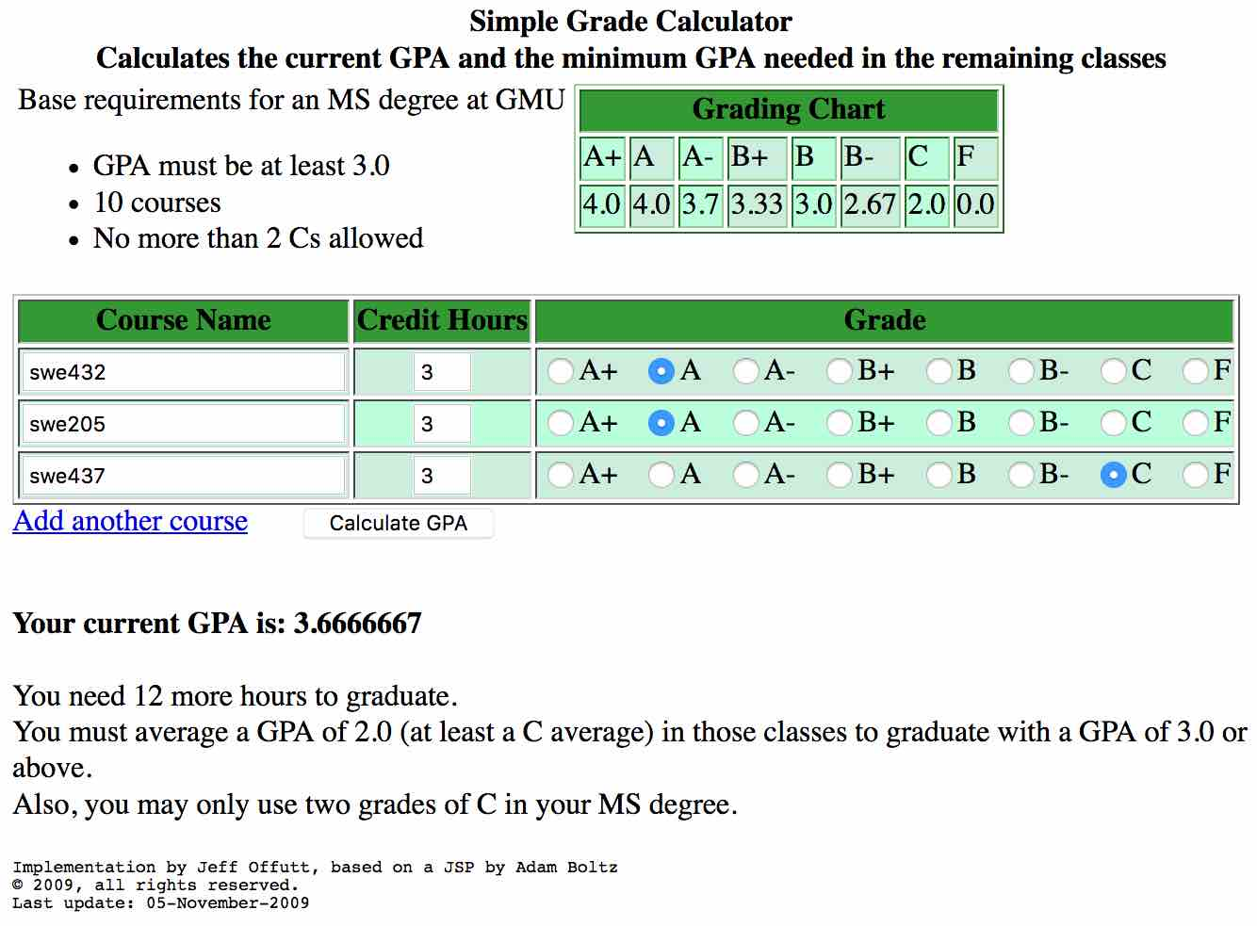
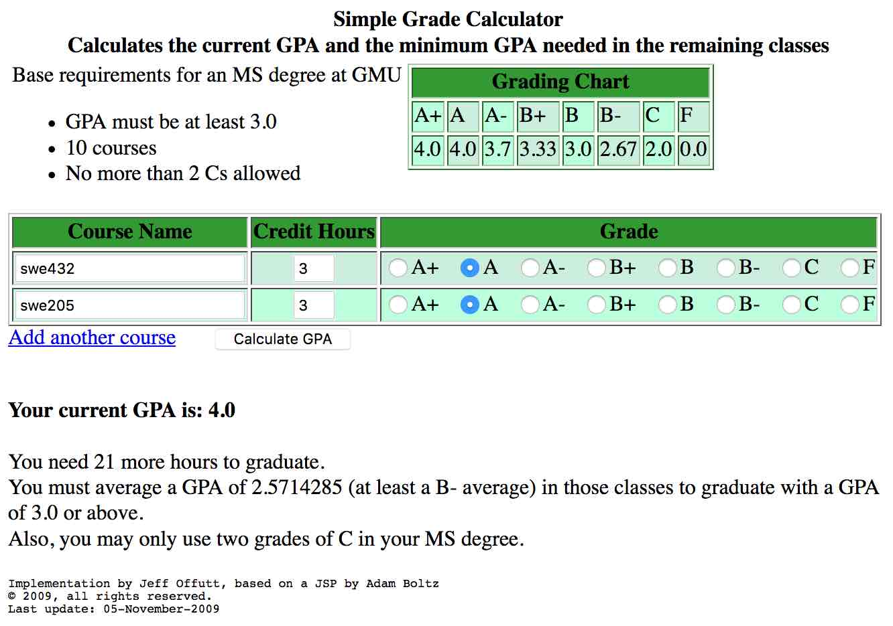
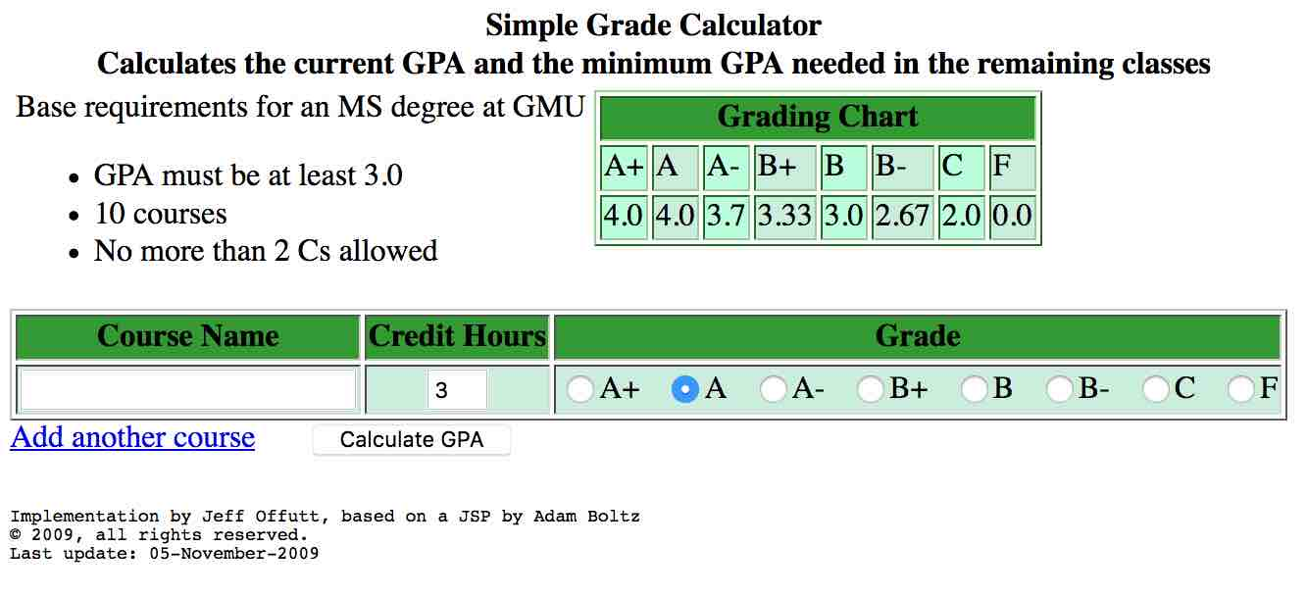
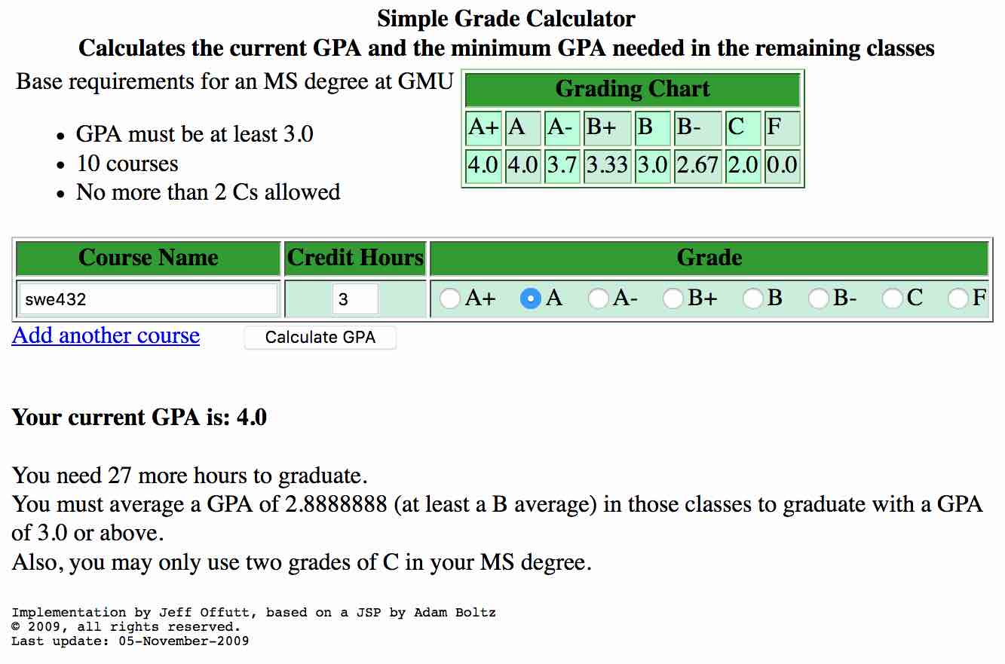
Ch #6 – Server-side State Management
session scope
Current GPA
4.0 (4*3)/3
4.0 (4*3 + (4*3 + 4*3)) / 9
3.6666667 (4*3 +
(4*3 + 4*3) +
(4*3 + 4*3 + 2*3)) / 18
Credit hours needed
30 more
27 more (30-3)
21 more (30-3-6)
12 more (30-3-6-9)

Slide 14
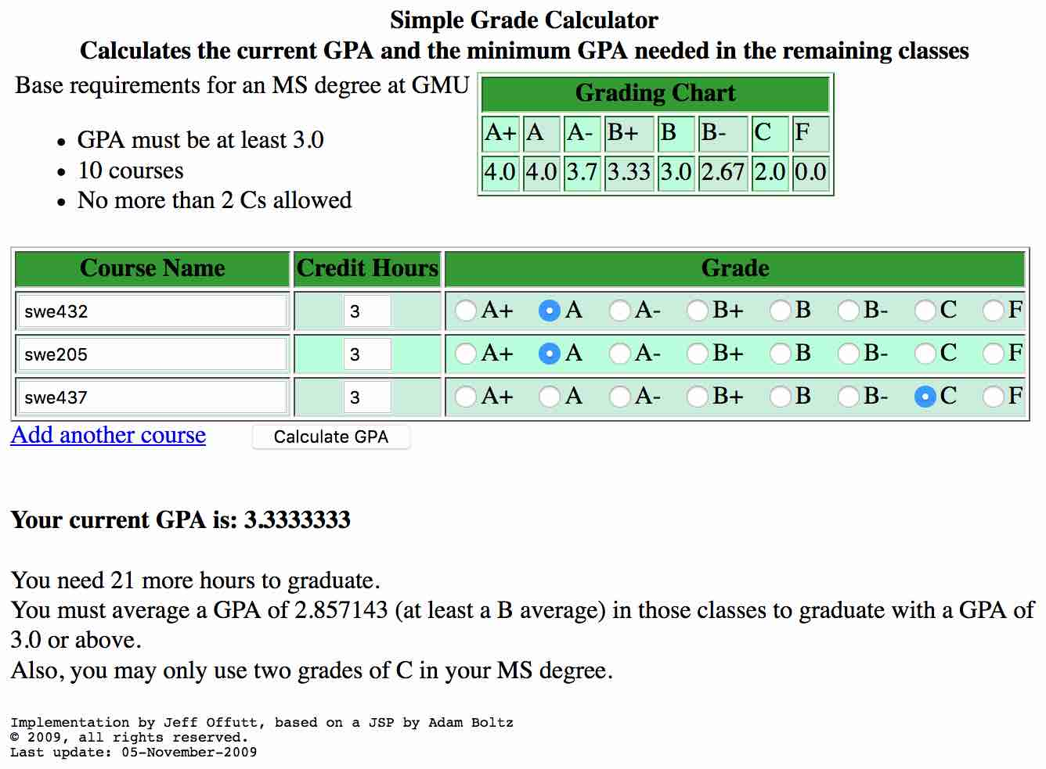
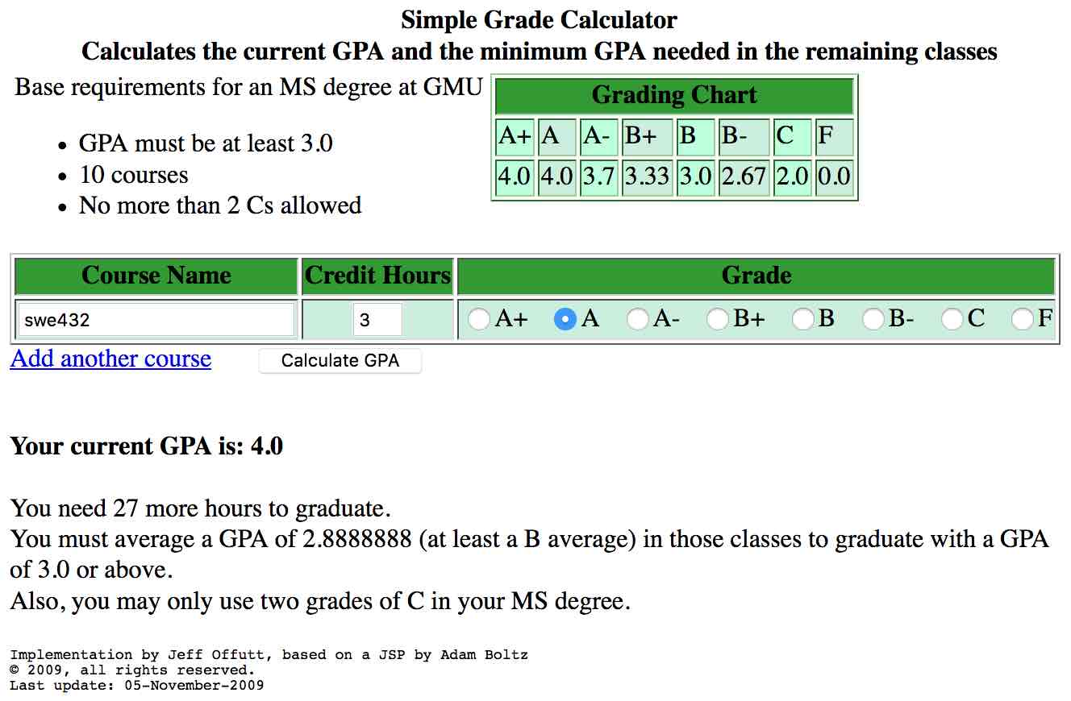
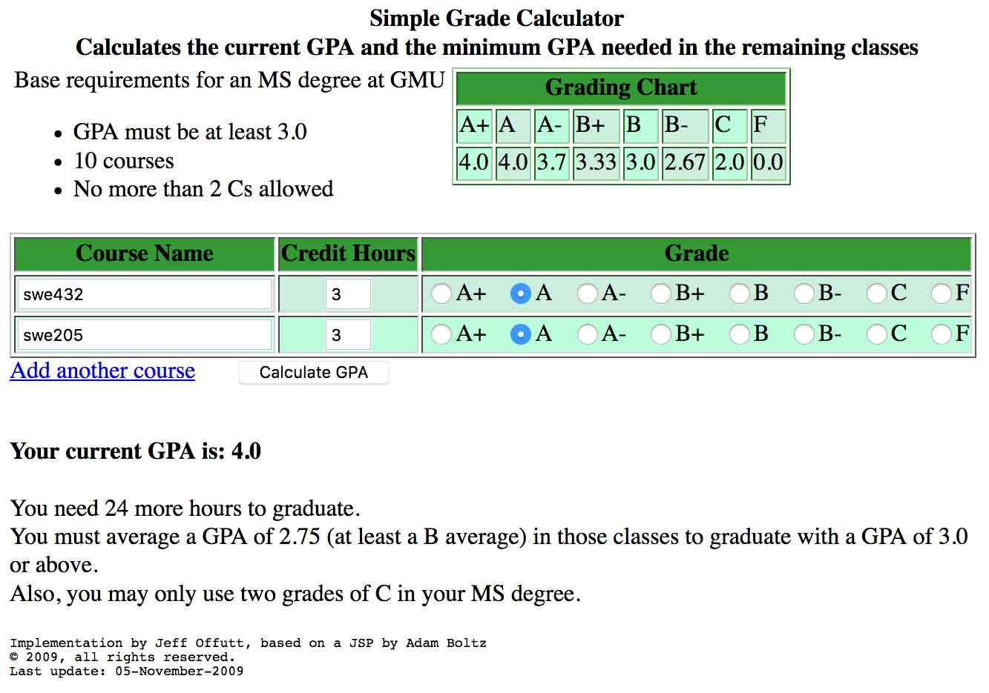
Ch #6 – Server-side State Management
page scope
Current GPA
4.0 (4*3)/3
4.0 (4*3 + 4*3) / 6
3.3333333
(4*3 + 4*3 + 2*3) / 9
Credit hours needed
30 more
27 more (30-3)
24 more (30-6)
21 more (30-9)

Slide 15
Ch #6 – Server-side State Management
Potential faults:
inappropriate scope setting
(objects/data are accessible
when they should not be)
session scope
page scope
Notes:
Traditional software do not have these features but we must consider them when testing web apps

Slide 16
Problem
New features => Challenges => interaction faults.
Improperly implementing and testing the communications among web components => interaction faults.
Traditional software testing techniques => insufficient
Current testing techniques are not effective at finding interaction faults.
Notes:
New features => new faults
Little knowledge for how to test web apps
Quality testing is very rare
Traditional software testing techniques are insufficient for testing web apps due to the new features

Slide 17
Motivation
Provide more sophisticated testing than current practice
Provide an evaluation criterion for other test selection strategies
Filter redundant pre-existing tests
Improve our ability to deliver quality web apps through stronger testing
Solution: mutation testing on web apps

Slide 18
Mutation Testing
Subject programs
Run tests on subject program
Killing
mutant
Apply
mutation operators
Generate tests
no
yes
Record
killed
mutants
Distinguishable result?
mutants
Run tests on mutants
Must be
valid strings
(compilable)
Mutants are not tests, but used to find tests

Slide 19
From Challenges to Fault Model
Challenges | Potential Faults
1. Users’ ability to control web apps | Unintended transitions caused by the user via a web browser or intentionally bypass the app validation
2. Identifying web resources with URLs | Incorrect or inappropriate URLs
3. Comm. depending on HTTP requests | Incorrect transfer mode (GET vs POST)
4. Comm. via data exchanges | Mismatched parameters
5. Novel control connections | Incorrect use between redirect and forward transitions
6. Server-side state management | Incorrect scope setting
 | Not initializing a session when it should be
 | Omitting necessary session info
7. Client-side state management | Omitting necessary info about hidden form fields
 | Submitting incorrect info about hidden form fields
 | Omitting necessary read-only info

Slide 20
Web Mutation Operators
Challenges | Potential Faults | Web Mutation Operators
1. Users’ ability to control web apps | Unintended transitions caused by the user via a web browser or intentionally bypass the app validation | FOB | Insert a dummy URL to the browser history before the current URL (or screen)
2. Identifying web resources with URLs | Incorrect or inappropriate URLs | WLUR | Replace URL of href attr of an <A> tag
 |  | WLUD | Delete URL of href attr of an <A> tag
 |  | WFUR | Replace URL of href attr of an <form> tag
 |  | WRUR | Replace URL of sendRedirect method of an HttpServletResponse
 |  | WCUR | Replace URL of page attr of JSP forward action and JSP include action, and file attr of JSP include directive
3. Comm. depending on HTTP requests | Incorrect transfer mode (GET vs POST) | WFTR | Replace a transfer mode with another transfer mode
4. Comm. via data exchanges | Mismatched parameters | WPVD | Remove a parameter-value pair from JSP include action

Slide 21
Web Mutation Operators
Challenges | Potential Faults | Web Mutation Operators
5. Novel control connections | Incorrect use between redirect and forward transitions | WCTR | Replace a redirect transition with a forward transition and a forward transition with a redirect transition
6. Server-side state management | Incorrect scope setting | WSCR | Replace scope of <jsp:useBean> with another setting (page, request, session, application)
 | Not initializing a session object when it should be | WSIR | Change a session object initialization to the opposite behavior (i.e., whether to create an instance)
 | Omitting necessary session info | WSAD | Delete setAttribute method of a session object
7. Client-side state management | Omitting necessary info about hidden form fields | WHID | Delete a hidden form field
 | Submitting incorrect info about hidden form fields | WHIR | Replace value of a hidden form field with another value in the same application domain
 | Omitting necessary read-only info | WOID | Delete a read-only input control

Slide 22
Mutation Operator for Faults due to Operational Transitions
FOB – FailOnBack | <html> … <body> <body onload=“manipulatehistory()”> <script src=“failOnBack.js”></script> … </html>
failOnBack.js function manipulatehistory() { var currentpage = window.document.toString(); var currenturl = window.location.href; var pageData = window.document.toString(); // add a dummy url right before the current url history.replaceState( pageData, “dummyurl”, “failonback.html” ); history.pushState( currentpage, “currenturl”, currenturl); } // update the page content window.addEventListener( ‘popstate’, function(event) { window.location.reload(); });
URL_C
URL_C
URL_F
URL_P
URL_P
URL_2
URL_2
URL_1
URL_1
browser history

Slide 23
Example Test for FOB Mutant
@Test
public void test_FOB_1()
{
driver.get("http://localhost:8080/experiment/calculategpa.jsp");
assertEquals("Grade Calculator", driver.getTitle());
// simulate a form submission
WebElement element = driver.findElement(By.name("courseName1"));
element.sendKeys("swe1");
driver.findElement(By.xpath("//input[@type='radio' and @name='courseGrade1' and @value='B+']")).click();
WebElement btn = driver.findElement(By.xpath("//button[@name='submitCourses']"));
btn.click();
// check if system works properly when clicking the browser back button
driver.navigate().back();
assertEquals(true, driver.getPageSource().contains(
"Calculates the current GPA and the minimum GPA needed in the remaining classes"));
}

Slide 24
Mutation Operators for Faults due to Control Connection
WCTR – Control transition replacement | Public class logout extends HttpServlet { ... public void doGet( ... ) { ... response.sendRedirect(url₁); getServletContext().getRequestDispatcher(url₁) .forward(request, response); ... } }
 | Public class logout extends HttpServlet { ... public void doGet( ... ) { ... getServletContext().getRequestDispatcher(url₁) .forward(request, response); response.sendRedirect(url₁); ... } }

Slide 25
Mutation Operators for Faults due to Server-Side State Management
WSCR – Scope replacement | <html> … <jsp:useBean id = id₁ scope = “page” class = class₁ /> <jsp:useBean id = id₁ scope = “session” class = class₁ /> … </html>
WSIR – Session initialization replacement | Public class logout extends HttpServlet { public void doGet( ... ) { session = request.getSession(true); session = request.getSession(false); ... } }
WSAD – Session setAttribute deletion | Public class logout extends HttpServlet { public void doGet( ... ) { session.setAttribute(attr₁ , value₁ ); // session.setAttribute(attr₁ , value₁ ); ... } }

Slide 26
Example Test for WSCR Mutant
@Test
public void test_WSCR_1()
{
driver.get("http://localhost:8080/experiment/calculategpa.jsp");
assertEquals("Grade Calculator", driver.getTitle());
// simulate a form submission
WebElement element = driver.findElement(By.name("courseName1"));
element.sendKeys("swe1");
driver.findElement(By.xpath("//input[@type='radio' and @name='courseGrade1' and @value='A']")).click();
WebElement btn = driver.findElement(By.xpath("//button[@name='submitCourses']"));
btn.click();
assertEquals(true, driver.getPageSource().contains("Your current GPA is: 4.0"));
// simulate another form submission
WebElement linkelement = driver.findElement(By.linkText("Add another course"));
linkelement.click();
element = driver.findElement(By.name("courseName2"));
element.sendKeys("swe2");
driver.findElement(By.xpath("//input[@type='radio' and @name='courseGrade2' and @value='B']")).click();
btn = driver.findElement(By.xpath("//button[@name='submitCourses']"));
btn.click();
assertEquals(true, driver.getPageSource().contains("You need 24 more hours to graduate."));
}

Slide 27
Mutation Operators for JS Web App
[“Efficient JavaScript Mutation Testing,” S. Mirshokraie, A. Mesbah, and K. Pattabiraman]

Slide 28
Mutation Operators for JS Web App
[“Efficient JavaScript Mutation Testing,” S. Mirshokraie, A. Mesbah, and K. Pattabiraman]

Slide 29
Summary
Mutation is widely considered the strongest test criterion
Some Java mutation operators can be applied to web apps but operators dealing with web-specific features are needed
Mutation operators have been defined for Java web app and JavaScript
Current mutation testing tools for web apps apply to source code. Program schema may be used to speed up the tool
Equivalent mutants are hand-analysis … we need to develop more cost-effective approach
Correlation between web mutation operators and fault severity can be useful for software maintenance and repair

